Slide 1
Entertainment Industry Analysis -PROJECT
Ajay .P
Entertainment Dataset Insights
25/6/2025

Slide 2
Dataset Overview :-
Source: Mockaroo (simulated entertainment dataset).
Attributes: Title, Genre, Platform, Country, Region, Revenue, Budget, Profit, Release Date, Download Count, Awards Won.
Key Features:
Mix of categorical and numerical fields
Allows trend, profitability, and regional analysis

Slide 3
Dashboard Overview :
Design Highlights:
KPI Cards: Total Revenue, Avg Budget, Total Profit, etc..
Charts: Region-wise, Genre-wise, Platform-wise, etc.,
Advanced charts –like line & Trend Line, pareto charts , heat maps.
Filters: Region, Platform, Genre, year, etc..
Interactivity:
Dynamic filters to isolate regions or Genre
Tooltip highlights for key metrics

Slide 4
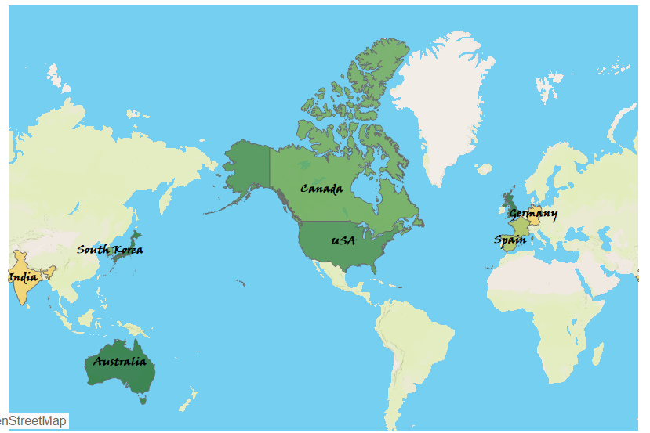
Chart’s – snippets (screen shot) :
MAP CHART
Visualizes total sales performance by geographic region.
Countries with shades indicate higher revenue.
Helps identify high-performing markets at a glance.
Useful for regional strategy planning and targeted marketing

Slide 5
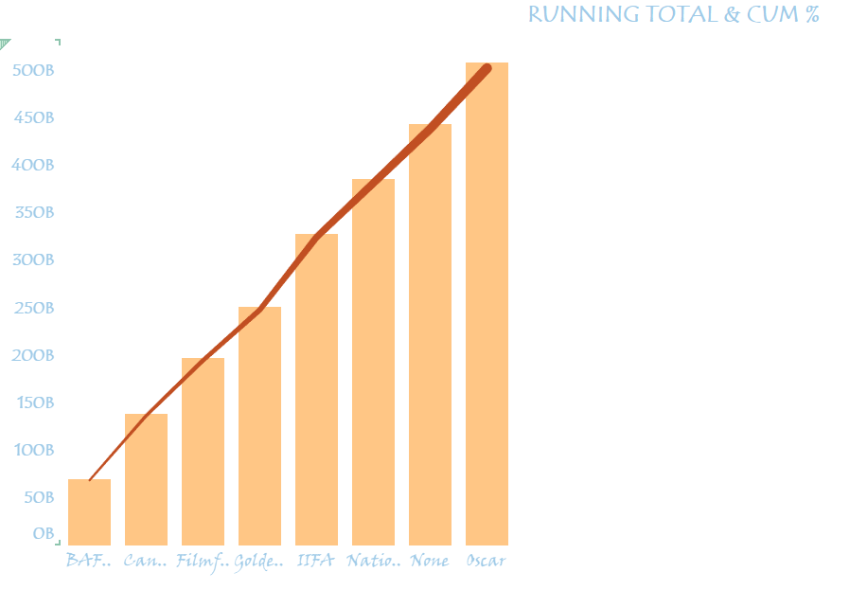
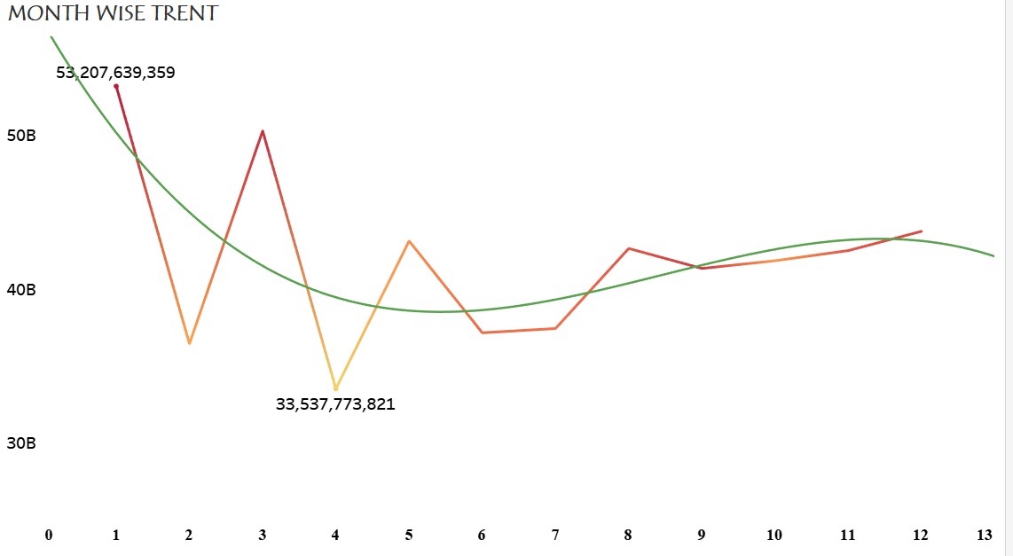
ADVANCED CHARTS
PARETO CHART
Pareto Chart : highlights the 80/20 rule. The bars show Running sum of revenue based on their award.
The line represents the cumulative percentage, helping identify the most impactful segments.
The Line Chart shows how Profit changes over time, helping spot growth or drop periods.
The Trend Line adds a predictive line showing the overall direction—upward, flat, or downward
LINE & TREND LINE -CHART

Slide 6
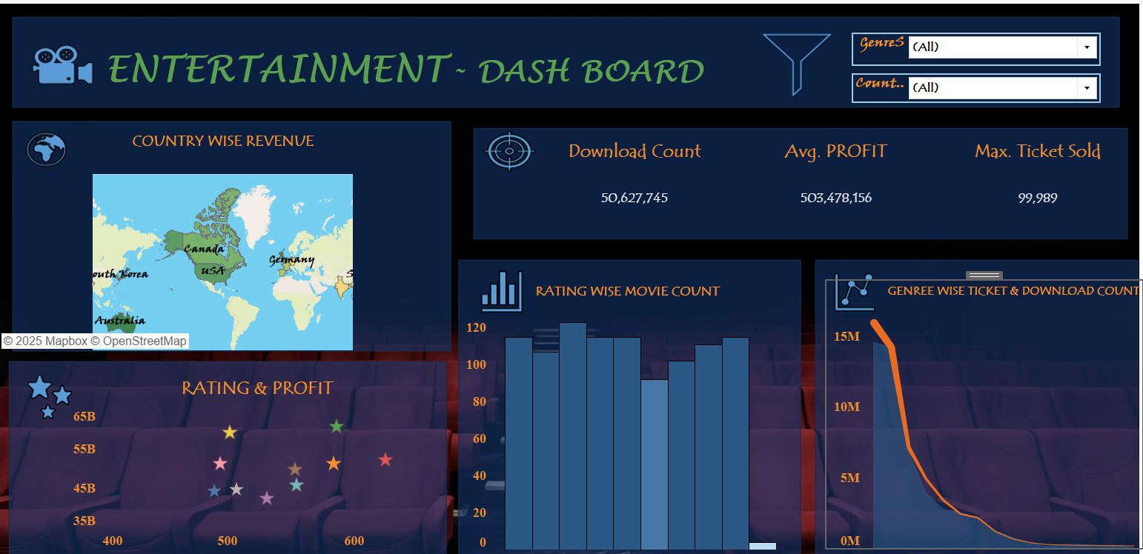
DASH BOARD :
This dashboard provides a holistic view of the entertainment dataset, combining key visual elements for data-driven insights,
Quickly identify top-performing regions and genres.
Understand seasonal trends and market shifts

Slide 7
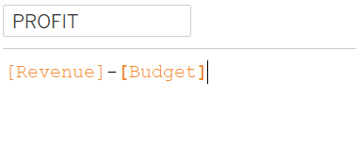
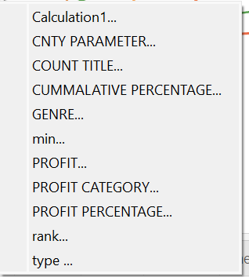
CALCULATED FIELDS :
Calculated fields are custom formulas created to perform calculations on your data.
.
Where I Used Them in This Project
Bar & Pareto Charts: Used Profit Category, Revenue Band, and Region-wise aggregation to visualize performance.
Trend Line Sheet: Used Profit over Time, which likely includes calculated date groupings (e.g., by month or year), Etc …

Slide 8
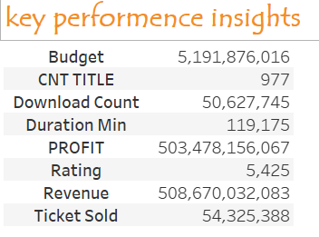
Key Insights :
This is high-level snapshot of the entertainment dataset. It highlights:
Massive revenue of ₹508B and profit of ₹503B
Strong audience engagement through 54M+ ticket sales and 50M+ downloads
These metrics reflect the scale, success, and digital reach of the industry.

Slide 9
Conclusion :
Summary:
Tableau dashboard reveals meaningful entertainment industry patterns.
Insights guide better production and marketing strategies.
Real-World Applications.
Region-specific promotion
Budget optimization and platform targeting

Slide 10
QUESTIONS :
THANK YOU.. !!!

